Slide 1

Angular 16
Prasad

Slide 2
@input @output Template Reference Communication @viewChild Content Projection

Slide 3
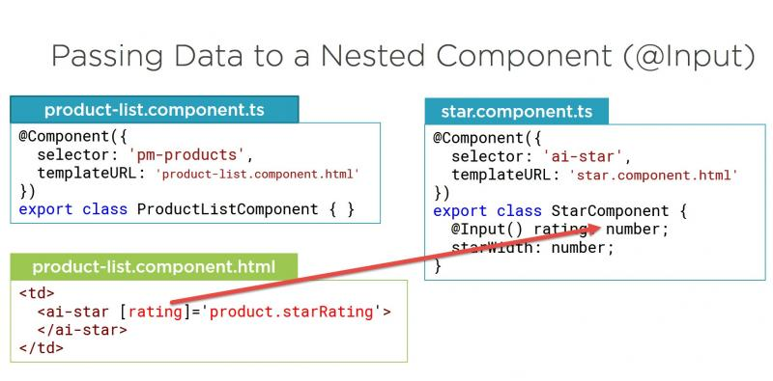
@Input
The @Input decorator allows you to pass data from a parent component to a child component. It is typically used for properties that a parent component wants to share with its child components.

Slide 4
@Input
parent.component.ts:
import { Component } from '@angular/core';
@Component({
selector: 'app-parent',
template: `
<app-child [message]="parentMessage"></app-child>
`,
})
export class ParentComponent {
parentMessage = 'Hello from the parent component!';
}
//Child Component:
child.component.ts:
import { Component, Input } from '@angular/core';
@Component({
selector: 'app-child',
template: `
<p>{{ message }}</p>
`,
})
export class ChildComponent {
@Input() message: string;
}

Slide 5
@Input
parent.component.ts:
import { Component } from '@angular/core';
@Component({
selector: 'app-parent',
template: `
<app-child [person]="parentPerson"></app-child>
`,
})
export class ParentComponent {
parentPerson = {
name: 'Alice',
age: 25,
};
}
//Child Component:
child.component.ts:
import { Component, Input } from '@angular/core';
@Component({
selector: 'app-child',
template: `
<p>Name: {{ person.name }}</p>
<p>Age: {{ person.age }}</p>
`,
})
export class ChildComponent {
@Input() person: { name: string; age: number };
}

Slide 6
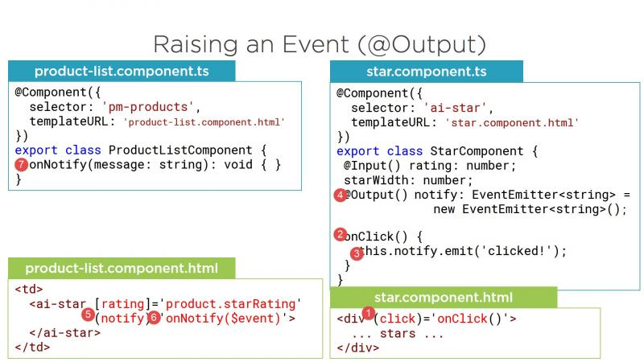
@Output
The @Output decorator allows you to emit custom events from a child component to its parent component. This is useful for handling user interactions in child components and notifying the parent component about those interactions.

Slide 7
@Output
//parent component
import { Component } from '@angular/core';
@Component({
selector: 'app-parent',
template: `
<app-child (messageEvent)="receiveMessage($event)">
</app-child>
<p>{{ receivedMessage }}</p>
`,
})
export class ParentComponent {
receivedMessage: string;
receiveMessage(message: string) {
this.receivedMessage = message;
}
}
//child Component
import { Component, Output, EventEmitter } from '@angular/core';
@Component({
selector: 'app-child',
template: `
<button (click)="sendMessage()">Send Message</button>
`,
})
export class ChildComponent {
@Output() messageEvent = new EventEmitter<string>();
sendMessage() {
this.messageEvent.emit('This is a message from the child component.');
}
}

Slide 8
@Output
parent.component.ts:
import { Component } from '@angular/core';
@Component({
selector: 'app-parent',
template: `
<app-child (messageEvent)="receiveMessage($event)"></app-child>
<p>{{ receivedMessage }}</p>
`,
})
export class ParentComponent {
receivedMessage: string;
receiveMessage(message: string) {
this.receivedMessage = message;
}
}
child.component.ts:
import { Component, Output, EventEmitter } from '@angular/core';
@Component({
selector: 'app-child',
template: `
<button (click)="sendMessage()">Send Message</button>
`,
})
export class ChildComponent {
@Output() messageEvent = new EventEmitter<string>();
sendMessage() {
const message = 'Hello from the child component!';
this.messageEvent.emit(message);
}
}

Slide 9
@viewChild
The @ViewChild decorator allows you to access a child component or an HTML element within the component's view. This is particularly useful for programmatically interacting with child components or DOM elements.
// ParentComponent
import { Component, ViewChild, AfterViewInit } from '@angular/core';
import { ChildComponent } from './child.component';
@Component({
selector: 'app-parent',
template: `
<app-child></app-child>
`,
})
export class ParentComponent implements AfterViewInit {
@ViewChild(ChildComponent) child: ChildComponent;
ngAfterViewInit() {
this.child.doSomething(); // Call a method in the ChildComponent
}
}
// ChildComponent
import { Component } from '@angular/core';
@Component({
selector: 'app-child',
template: `
<p>Child Component</p>
`,
})
export class ChildComponent {
doSomething() {
console.log('Child component did something.');
}
}

Slide 10
@viewChild
parent.component.ts:
import { Component, ViewChild, AfterViewInit } from '@angular/core';
import { ChildComponent } from './child.component';
@Component({
selector: 'app-parent',
template: `
<app-child></app-child>
<button (click)="invokeChildMethod()">Invoke Child Method</button>
`,
})
export class ParentComponent implements AfterViewInit {
@ViewChild(ChildComponent) childComponent: ChildComponent;
ngAfterViewInit() {
// Access child component after view is initialized
}
invokeChildMethod() {
this.childComponent.sayHello();
}
}
Child.component.ts
import { Component } from '@angular/core';
@Component({
selector: 'app-child',
template: `
<p>Child Component</p>
`,
})
export class ChildComponent {
sayHello() {
console.log('Hello from the child component!');
}
}

Slide 11
Template Reference Variable
parent.component.ts:
import { Component } from '@angular/core';
@Component({
selector: 'app-parent',
template: `
<app-child #childRef></app-child>
<button (click)="receiveMessage(childRef.message)">Receive Message</button>
`,
})
export class ParentComponent {
receiveMessage(message: string) {
console.log('Received message from child:', message);
}
}
child.component.ts:
import { Component } from '@angular/core';
@Component({
selector: 'app-child',
template: `
<button (click)="sendMessage()">Send Message</button>
`,
})
export class ChildComponent {
message = 'Hello from the child component!';
sendMessage() {
console.log('Sending message to parent');
}
}

